Slide 1
Lecture Presentation - 2
Chapter 4: Ohm’s Law, Power and Energy
Abu Ahmed Ferdaus, CSE, DU.

Slide 2
This lecture includes:
Ohm’s Law
Power
Wattmeter
Energy
Circuit Breaker and Fuses
Abu Ahmed Ferdaus, CSE, DU.

Slide 3

4.2 Ohm’s Law
Every conversion of energy from one form to another can be related to the above equation.
In electric circuits, the effect is the flow of charge, or current. The potential difference, or voltage, between two points is the cause (“pressure”), and the opposition is the resistance encountered.
Abu Ahmed Ferdaus, CSE, DU.

Slide 4
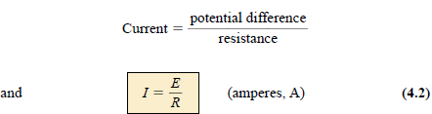
4.2 Ohm’s Law
The following equation is known as Ohm’s Law in honour of Georg Simon Ohm
For a fixed resistance, the greater the voltage (or pressure) across a resistor, the more the current, and the more the resistance for the same voltage, the less the current.
In other words, the current is proportional to the applied voltage and inversely proportional to the resistance.
Abu Ahmed Ferdaus, CSE, DU.

Slide 5

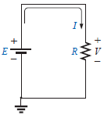
4.2 Ohm’s Law
The voltage and resistance can be found in terms of the other two quantities:
The three quantities of Eqs. (4.2) through (4.4) are defined by the simple circuit:
Note:
the symbol E is applied to all sources of voltage
the symbol V is applied to all voltage drops
across components of the network.
Abu Ahmed Ferdaus, CSE, DU.

Slide 6
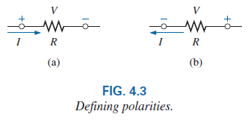

4.2 Ohm’s Law
Since the battery in Fig. 4.2 is connected directly across the resistor, the voltage V_{R} across the resistor must be equal to that of the supply. Applying Ohm’s law:
The voltage source “pressures” current (conventional current) in a direction that leaves the positive terminal of the supply and returns to the negative terminal of the battery (for single-source networks).
Note also that the current enters the positive terminal and leaves the negative terminal for the load resistor R.
For any resistor, in any network, the direction of current through a resistor will define the polarity of the voltage drop across the resistor.
Abu Ahmed Ferdaus, CSE, DU.

Slide 7
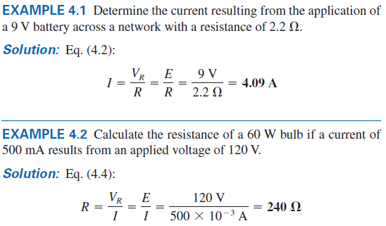
4.2 Example 4.1 / 4.2
Abu Ahmed Ferdaus, CSE, DU.

Slide 8
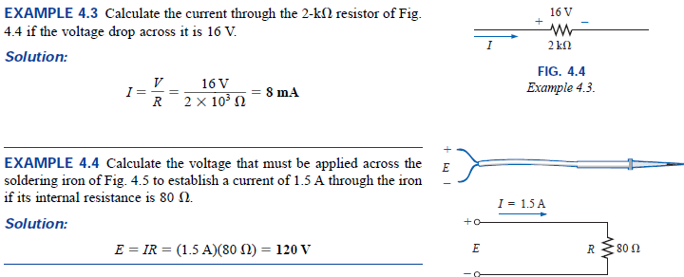
4.2 Example 4.3 /4.4
Abu Ahmed Ferdaus, CSE, DU.

Slide 9
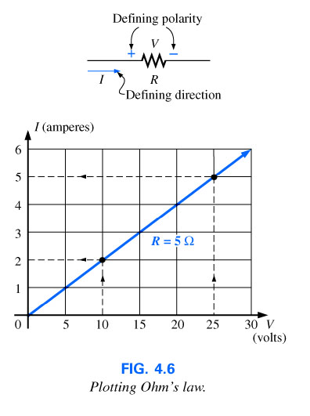
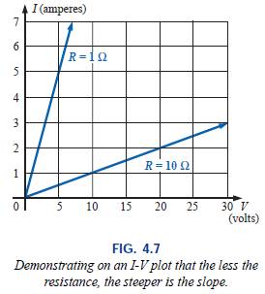
4.3 Plotting Ohm’s Law
Abu Ahmed Ferdaus, CSE, DU.

Slide 10
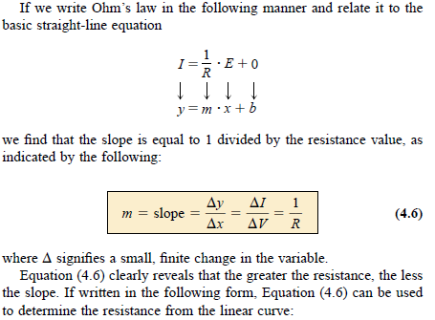
4.3 Plotting Ohm’s Law
Abu Ahmed Ferdaus, CSE, DU.

Slide 11

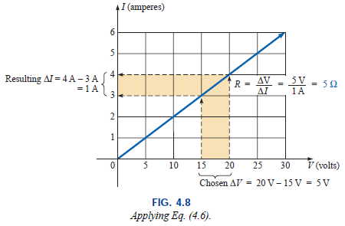
4.3 Plotting Ohm’s Law
Abu Ahmed Ferdaus, CSE, DU.

Slide 12
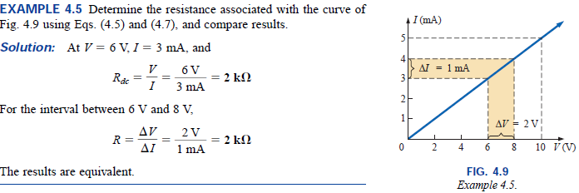
4.3 Example 4.5
Abu Ahmed Ferdaus, CSE, DU.

Slide 13
4.4 Power
Power is an indication of how much work (the conversion of energy from one form to another) can be done in a specified amount of time, that is, a rate of doing work.
A large motor has more power than a small motor because it can convert more electrical energy into mechanical energy in the same period of time.
Since converted energy is measured in joules (J) and time in seconds (s), power is measured in joules/second (J/s).
The electrical unit of measurement for power is the watt (W), defined by:
1 Watt (W) = 1 joule/second (J/s) (4.8)
Abu Ahmed Ferdaus, CSE, DU.

Slide 14

4.4 Power
In equation form, power is determined by
horsepower (hp) is a measure of the average power of a strong dray (small cart) horse over a full working day. It is approximately 50% more than can be expected from the average horse. The horsepower and watt are related in the following manner:
1 horsepower =746 Watts
Abu Ahmed Ferdaus, CSE, DU.

Slide 15
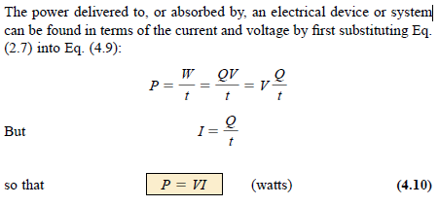
4.4 Power
Abu Ahmed Ferdaus, CSE, DU.

Slide 16
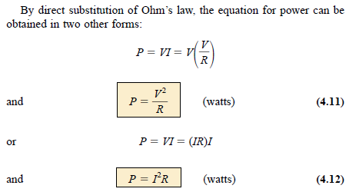
4.4 Power
Abu Ahmed Ferdaus, CSE, DU.

Slide 17
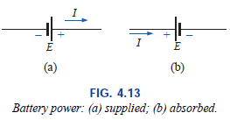
4.4 Power
Power can be delivered or absorbed as defined by the polarity of the voltage and the direction of the current.
For all dc voltage sources, power is being delivered by the source if the current has the direction appearing in Fig. 4.13(a). The current has the same direction as established by the source in a single-source network.
If the current direction and polarity are as shown in Fig. 4.13(b) due to a multisource network, the battery is absorbing power much as when a battery is being charged.
Abu Ahmed Ferdaus, CSE, DU.

Slide 18
4.4 Power
The magnitude of the power delivered or absorbed by a battery is given by
with E the battery terminal voltage and I the current through the source.
Abu Ahmed Ferdaus, CSE, DU.

Slide 19
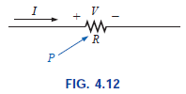
4.4 Power
For resistive elements, all the power delivered is dissipated in the form of heat because the voltage polarity is defined by the current direction (and vice versa).
A reversal of the current direction in Fig. 4.12 will also reverse the polarity of the voltage across the resistor.
Abu Ahmed Ferdaus, CSE, DU.

Slide 20
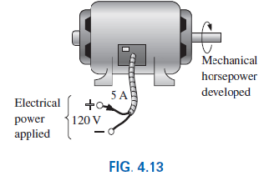

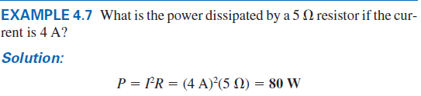
4.4 Power
Abu Ahmed Ferdaus, CSE, DU.

Slide 21
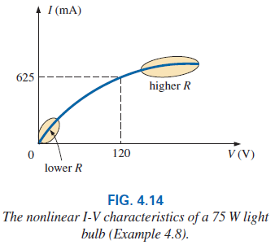
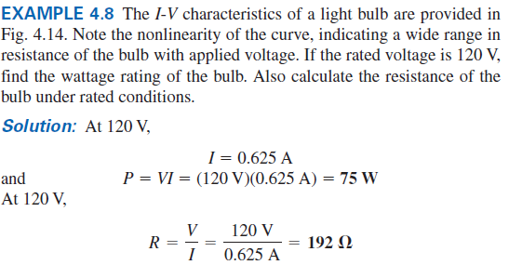
4.4 Power
Abu Ahmed Ferdaus, CSE, DU.

Slide 22
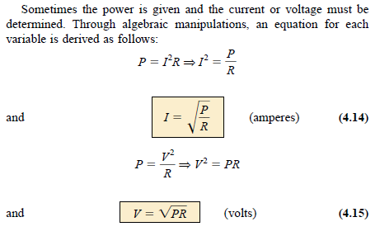
4.4 Power
Abu Ahmed Ferdaus, CSE, DU.

Slide 23

4.4 Example 4.9
Determine the current through a 5-k resistor when the power dissipated by the element is 20 mW.
Abu Ahmed Ferdaus, CSE, DU.

Slide 24
4.5 Energy
For power, which is the rate of doing work, to produce an energy conversion of any form, it must be used over a period of time. For example, a motor may have the horsepower to run a heavy load, but unless the motor is used over a period of time, there will be no energy conversion.
In addition, the longer the motor is used to drive the load, the greater will be the energy expended.
The energy (W) lost or gained by any system is therefore determined by
Abu Ahmed Ferdaus, CSE, DU.

Slide 25
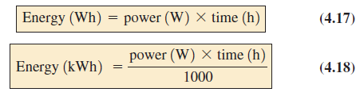
4.5 Energy
Since power is measured in watts (or joules per second) and time in seconds, the unit of energy is the wattsecond or joule as indicated above.
The wattsecond, however, is too small a quantity for most practical purposes, so the watthour (Wh) and kilowatthour (kWh) were defined, as follows:
To develop some sense for the kilowatthour energy level, consider that 1 kWh is the energy dissipated by a 100W bulb in 10 h.
Abu Ahmed Ferdaus, CSE, DU.

Slide 26
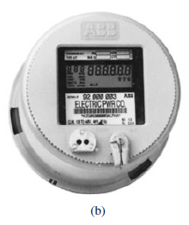
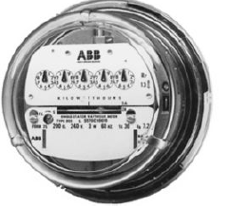
4.5 Energy
The kilowatthour meter is an instrument for measuring the energy supplied to the residential or commercial user of electricity.
It is normally connected directly to the lines at a point just prior to entering the power distribution panel of the building.
Abu Ahmed Ferdaus, CSE, DU.

Slide 27
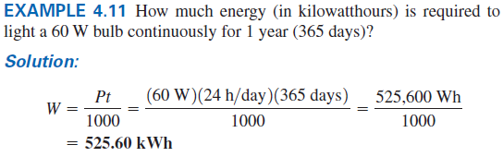
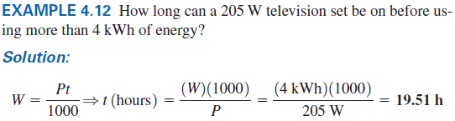
4.5 Example 4.11 / 4.12
Abu Ahmed Ferdaus, CSE, DU.

Slide 28
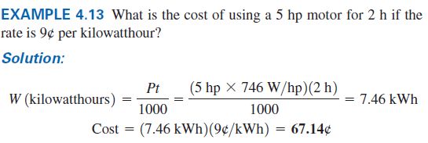
4.5 Example 4.13
Abu Ahmed Ferdaus, CSE, DU.

Slide 29
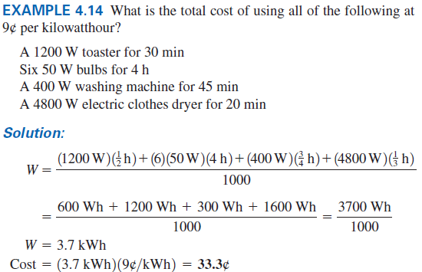
4.5 Example 4.14
Abu Ahmed Ferdaus, CSE, DU.

Slide 30
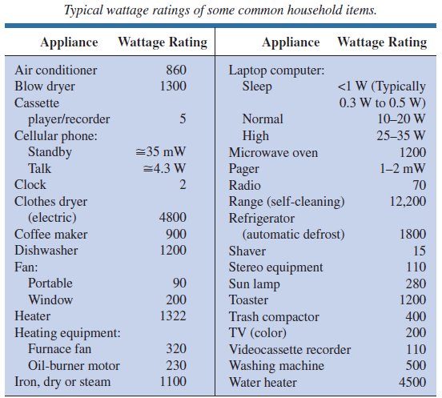
4.5 Energy
Abu Ahmed Ferdaus, CSE, DU.

Slide 31
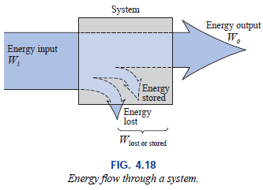
4.6 Efficiency
A flowchart for the energy levels associated with any system that converts energy from one form to another is provided in Fig. 4.18. The output energy level must always be less than the applied energy due to losses and storage within the system.
Conservation of energy requires that
Energy input = energy output + energy lost or stored in the system
Abu Ahmed Ferdaus, CSE, DU.

Slide 32
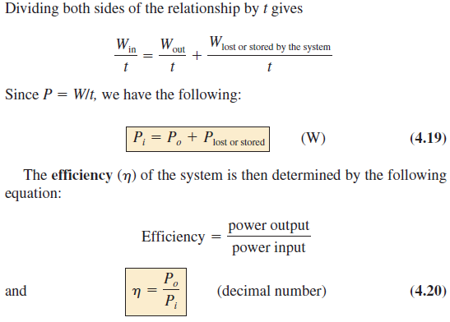
4.6 Efficiency
Abu Ahmed Ferdaus, CSE, DU.

Slide 33
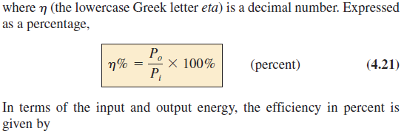
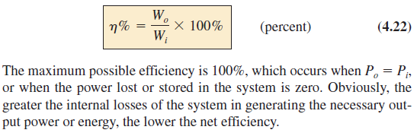
4.6 Efficiency
Abu Ahmed Ferdaus, CSE, DU.

Slide 34
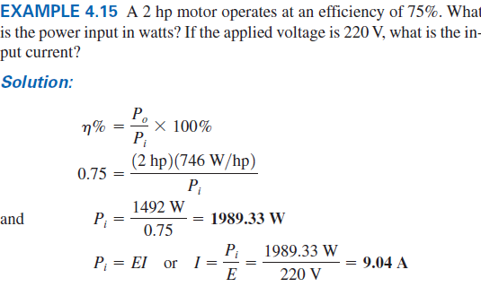
4.6 Example 4.15
Abu Ahmed Ferdaus, CSE, DU.

Slide 35
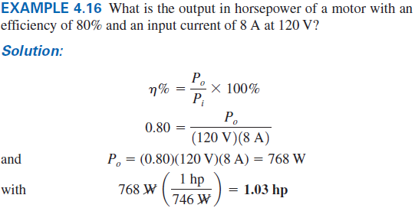
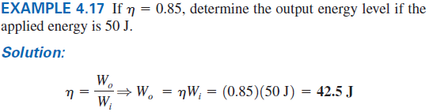
4.6 Example 4.16 / 4.17
Abu Ahmed Ferdaus, CSE, DU.

Slide 36
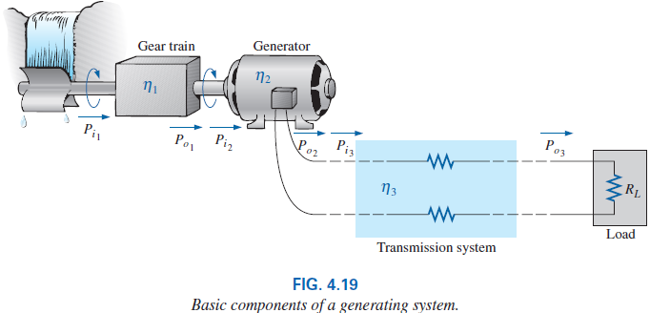
4.6 Efficiency
The very basic components of a generating (voltage) system are depicted below, each component has an associated efficiency, resulting in a loss of power through each stage.
Abu Ahmed Ferdaus, CSE, DU.

Slide 37
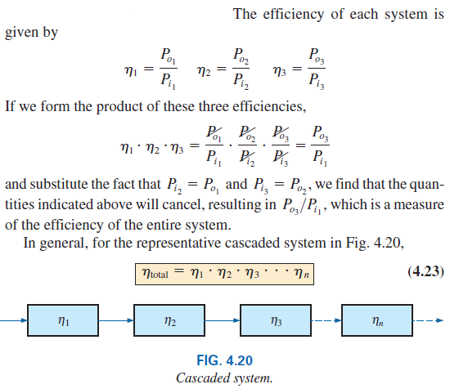
4.6 Efficiency of a Cascading System
Abu Ahmed Ferdaus, CSE, DU.

Slide 38
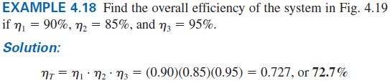
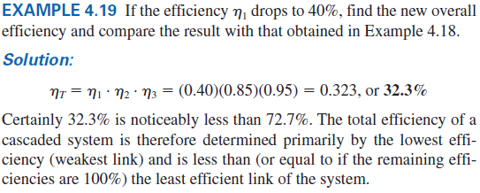
4.6 Example 4.18 / 4.19
Abu Ahmed Ferdaus, CSE, DU.

Slide 39
4.7 Circuit Breaker, GFCIs and Fuses
The incoming power to any large industrial plant, heavy equipment, simple circuit in the home, or to meters used in the laboratory must be limited to ensure that the current through the lines is not above the rated value.
Otherwise, the conductors or the electrical or electronic equipment may be damaged, and dangerous side effects such as fire or smoke may result.
To limit the current level, fuses or circuit breakers are installed where the power enters the installation, such as in the panel in the basement of most homes at the point where the outside feeder lines enter the dwelling.
Abu Ahmed Ferdaus, CSE, DU.

Slide 40
4.7 Circuit Breaker, GFCIs and Fuses
The fuses in Fig. 4.21 have an internal metallic conductor through which the current passes; a fuse begins to melt if the current through the system exceeds the rated value printed on the casing. Of course, if the fuse melts through, the current path is broken and the load in its path is protected.
Abu Ahmed Ferdaus, CSE, DU.

Slide 41
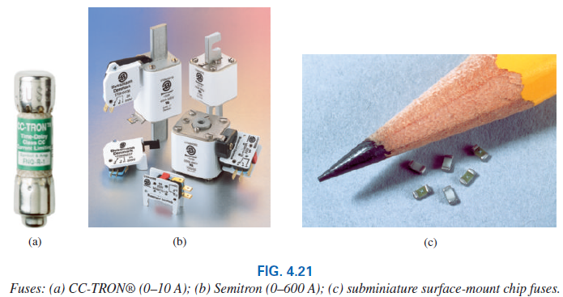
4.7 Circuit Breaker, GFCIs and Fuses
Abu Ahmed Ferdaus, CSE, DU.

Slide 42
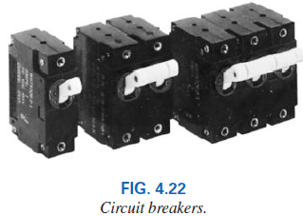
4.7 Circuit Breaker, GFCIs and Fuses
In homes built in recent years, fuses have been replaced by circuit breakers such as those appearing in Fig. 4.22.
When the current exceeds rated conditions, an electromagnet in the device will have sufficient strength to draw the connecting metallic link in the breaker out of the circuit and open the current path.
When conditions have been corrected, the breaker can be reset and used again.
Abu Ahmed Ferdaus, CSE, DU.

Slide 43
4.7 Circuit Breaker, GFCIs and Fuses
GFCI(Ground Fault Circuit Interrupter)s (often abbreviated GFI) (used in bathroom and other sensitive areas) are designed to trip more quickly than the standard circuit breaker.
It has been determined that 6 mA is the maximum level that most individuals can be exposed to for a short period of time without the risk of serious injury.
A current higher than 11 mA can cause involuntary muscle contractions that could prevent a person from letting go of the conductor and possibly cause him or her to enter a state of shock.
Higher currents lasting more than a second can cause the heart to go into fibrillation and possibly cause death in a few minutes.
Abu Ahmed Ferdaus, CSE, DU.

Slide 44
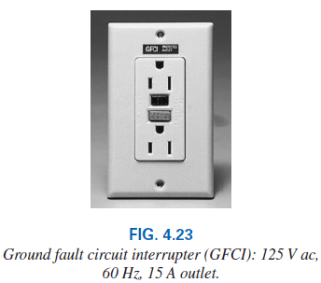
4.7 Circuit Breaker, GFCIs and Fuses
The GFCI is able to react as quickly as it does by sensing the difference between the input and output currents to the outlet; the currents should be the same if everything is working properly.
An errant path, such as through an individual, establishes a difference in the two current levels and causes the breaker to trip and disconnect the power source.
Abu Ahmed Ferdaus, CSE, DU.

Slide 45
Glossary
Circuit breaker A two-terminal device designed to ensure that current levels do not exceed safe levels. If “tripped,” it can be reset with a switch or a reset button.
Diode A semiconductor device whose behavior is much like that of a simple switch; that is, it will pass current ideally in only one direction when operating within specified limits.
Efficiency (h) A ratio of output to input power that provides immediate information about the energy-converting characteristics of a system.
Energy (W) A quantity whose change in state is determined by the product of the rate of conversion (P) and the period involved (t). It is measured in joules (J) or wattseconds (Ws).
Abu Ahmed Ferdaus, CSE, DU.

Slide 46
Glossary
Fuse A two-terminal device whose sole purpose is to ensure that current levels in a circuit do not exceed safe levels.
Horsepower (hp) Equivalent to 746 watts in the electrical system.
Kilowatthour meter An instrument for measuring kilowatthours of energy supplied to a residential or commercial user of electricity.
Ohm’s law An equation that establishes a relationship among the current, voltage, and resistance of an electrical system.
Power An indication of how much work can be done in a specified amount of time; a rate of doing work. It is measured in joules/second (J/s) or watts (W).
Abu Ahmed Ferdaus, CSE, DU.

Slide 47
Thank You
Abu Ahmed Ferdaus, CSE, DU.

